Slide 1
Tableau
Assignment

Slide 2
What is Tableau?
Tableau is a powerful and fastest growing data visualization tool used in the Business Intelligence Industry. It helps in simplifying raw data in a very easily understandable format. Tableau helps create the data that can be understood by professionals at any level in an organization. It also allows non-technical users to create customized dashboards.
Data analysis is very fast with Tableau tool and the visualizations created are in the form of dashboards and worksheets.

Slide 3
Explain several option of the start page of tableau desktop.
The start page in Tableau Desktop is a central location from which you can do the following:
Connect to your data
Open your most recently used workbooks, and
Discover and explore content produced by the Tableau community.
The start page consists of three panes: Connect, Open, and Discover.

Slide 4
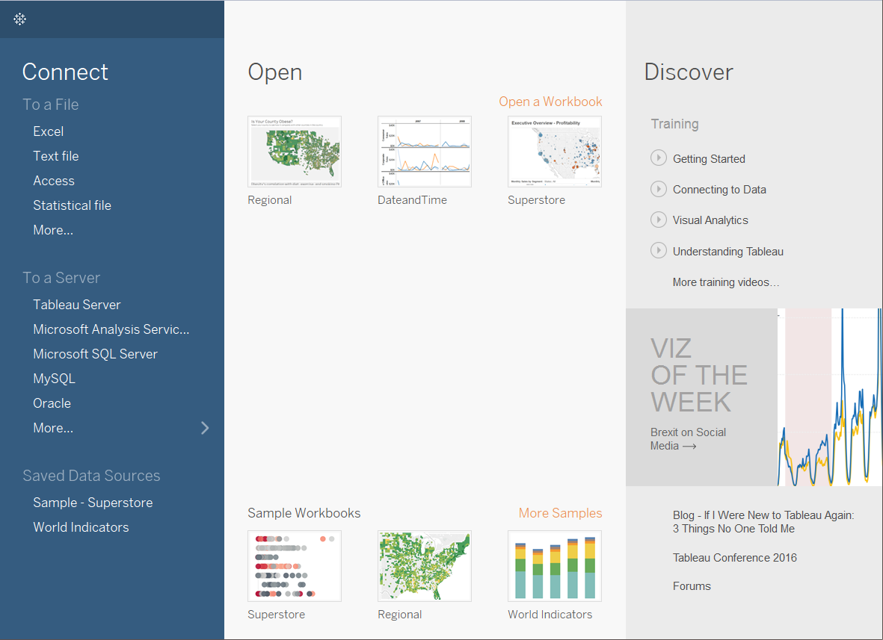
.

Slide 5
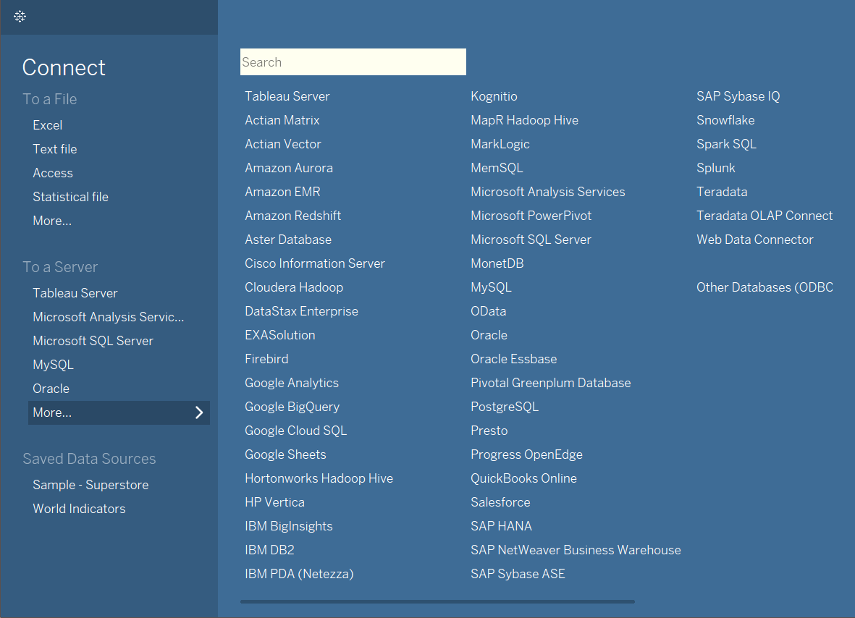
Connect Connect to data and open saved data sources.

Slide 6
.
On the Connect pane, you can do the following:
Connect to data: Under To a File, connect to data stored in Microsoft Excel files, text files, Access files, Tableau extract files, and statistical files, such as SAS, SPSS, and R. Under To a Server, connect to data stored in databases like Microsoft SQL Server or Oracle. The server names listed in this section change based on which servers you connect to and how often.
Open saved data sources: Quickly open data sources that you have previously saved to your My Tableau Repository directory. Also, Tableau provides sample saved data sources that you can use to explore Tableau Desktop functionality. To follow along with examples in the Tableau Desktop documentation, you'll usually use the Sample – Superstore data source.

Slide 7
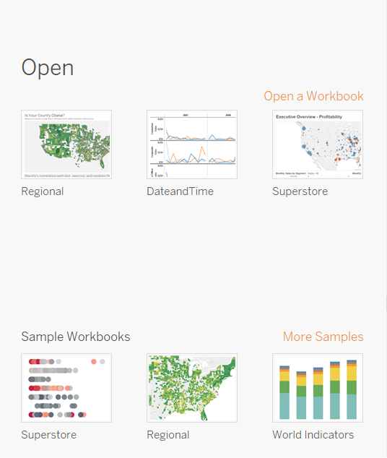
Open Open recent workbooks, pin workbooks to the start page, and explore sample workbooks.

Slide 8
.
On the Open pane, you can do the following:
Open recently opened workbooks: When you open Tableau Desktop for the first time, this pane is empty. As you create and save new workbooks, the most recently opened workbooks appear here. Click the workbook thumbnail to open a workbook, or if you don't see a workbook thumbnail, click the Open a Workbook link to find other workbooks that are saved to your computer.
Pin workbooks: You can pin workbooks to the start page by clicking the pin icon that appears in the top-left corner of the workbook thumbnail. Pinned workbooks always appear on the start page, even if they weren't opened recently. To remove a recently opened or pinned workbook, hover over the workbook thumbnail, and then click the "x" that appears. The workbook thumbnail is removed immediately but will show again with your most recently used workbooks the next time you open Tableau Desktop.
Explore sample workbooks: Open and explore sample workbooks.

Slide 9
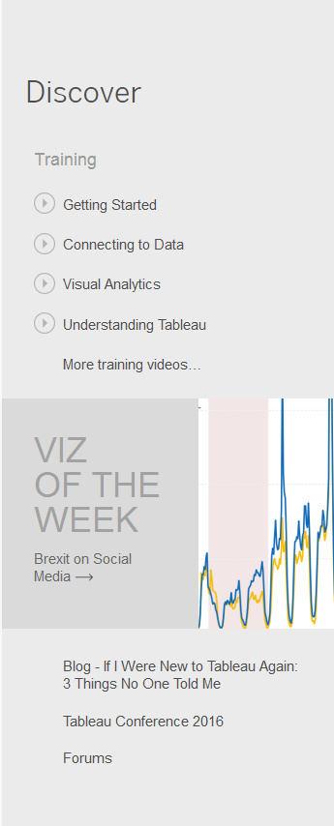
Discover See popular views in Tableau Public, read blog posts and news about Tableau, and find training videos and tutorials to help you get started.
.

Slide 10
Explain data architecture?
Tableau Server is designed to connect many data tiers. It can connect clients from Mobile, Web, and Desktop. Tableau Desktop is a powerful data visualization tool. It is very secure and highly available.
It can run on both the physical machines and virtual machines. It is a multi-process, multi-user, and multi-threaded system.
The various layers used in the Tableau server are given below
Data Server
Data Connectors
Components of Tableau Server
Gateway\Clients

Slide 11
Explain all the steps of process BI project?
Your BI strategy needs to first align with your business goals and vision. With business intelligence, data can drive transformation in your organization. This initiative will place trusted, relevant data in the hands of employees so they can make informed decisions every day. You can start this transformation now by following our Blueprint.
1. Choose a sponsor
Ideally, your choice to sponsor the project and get buy-in from other high-level employees should be an executive-level leader. Before you begin, you need participation and alignment on the vision of BI in the company. Organizations who value data in every department appoint a Chief Data Officer to sponsor the BI initiative. The CDO or other executive sponsor needs to consider the support and training required for deployment and consider how to scale this platform to the entire enterprise. Keep your sponsor up to date on your progress. When you have launched your BI platform, and it’s working as expected, generate some valuable, visible reports to share with your sponsor. Prove to your sponsor, and therefore the company, that your strategy is working. For more information, see Executive Sponsor Roles and Responsibilities in Tableau Blueprint.

Slide 12
.
2. Choose your BI platform
A BI software platform can do a lot, but it isn’t your entire BI strategy. Now that you have chosen a sponsor for this initiative, you can evaluate BI platforms to find a good fit for your plan. Many platforms share common functionalities, and you should rank on a scale of importance to the following features:
Data access and view of relevant content
Interactivity with data within a visual interface
Ability to dive deeper into data and discover new insights on your own
Promote new insight discoveries to a governed environment in a bottom-up approach
Collaborate with others on data analysis and sharing visualized analytics
For more information, see Evaluating a Modern BI Platform. Once you have decided who will be your BI sponsor and what platform to use for analysis, the next step is to identify and involve your key stakeholders.

Slide 13
.
3. Identify the key stakeholders and get them involved
Business intelligence may include software, but that doesn’t mean it’s only an IT project. BI also requires financial data, but that doesn’t mean it’s only the finance department’s concern. You should bring in a representative from every team affected by your BI plan. Get them involved early and interview them. Ask them how they use data in their work, what is working for them, and what isn’t working for them. Use those insights to tailor your BI scope. For more information, see Tableau Content Consumer Roles in Tableau Blueprint.
4. Assemble your BI team
Your BI team will be responsible for implementing your strategy. You can hire new people or have people fulfill multiple functions if your organization is small. BI platforms ensure that reports and dashboards are accessible and approachable to non-analysts (known as self-service business intelligence). However, to get the platform up and running correctly, you will need this cross-functional team to implement the BI plan. These are some of the roles and responsibilities for the BI project team:

Slide 14
.
An IT service owner or analytics director to manage the software platform
An enterprise architect who integrates the platform with the existing data architecture
A site administrator to organize the content, and create user groups and permissions
A data steward to put the data in context and document processes and procedures for using the platform
But these aren’t all the people involved in the project. You will also need a steering committee and executive sponsor to ensure the project is meeting its deadlines. For more information, see Tableau Project Team Roles and Responsibilities in Tableau Blueprint.
5. Define the scope of BI
Before you deploy business intelligence software, you need to decide what BI means to your organization. Business intelligence means using data to make business decisions. But you need to determine how that will work in the day-to-day operations of your company and which departments will use BI. For example, Coca-Cola created customized dashboards for customer service specialists. Chipotle created a unified view of their restaurant locations to compare performance between them.

Slide 15
.
HelloFresh created automated reporting of campaign results, saving hundreds of hours of analysis time. There are many examples of companies using business intelligence in innovative ways. Decide how you want to integrate BI to support your company objectives. After you define your operational definition of business intelligence, you should decide which divisions of your company to include first. Are you using business intelligence to understand and predict financial performance, human resources, supply chain, or inventory changes? Will you be analyzing a combination of these or something else entirely? The scope of analysis within the business needs to be clear before you move on to the next steps. Once the scope of analysis is clear, you need to choose what you want to measure within that data. Identify which metrics and reports would be the highest priority for your company’s leadership. These reports should include your key performance indicators (KPIs) that align with overall company goals to measure success. These can be internal metrics compared to past performance benchmarks, as well as external metrics. What KPIs indicate success in your industry? Competitive analysis is becoming a crucial part of business intelligence. BI tools are allowing organizations to monitor competitors’ performance, changes in the market, and customer behavior changes. You can do this by analyzing competitors’ case studies, blogs, articles, videos, etc. After defining your scope of business intelligence, you will probably realize just how big of a project it will be to implement BI. Now you must identify your people resources to implement your strategy. For more information, see Tableau Monitoring in Tableau Blueprint.

Slide 16
.
6. Prepare your data infrastructure
Business intelligence must have clear data sources to perform an accurate analysis. Traditionally, BI platforms import data from a data warehouse. With modern BI, you can analyze data from multiple sources. We differentiate between two types of data: trusted and untrusted. Trusted data is stored in databases or easily imported into databases such as spreadsheets, customer relationship management (CRM) data, financial data, etc. This is the data you probably have used in previous business analytics. Untrusted data is information such as emails, conversations with customers, business processes, images, news items, trade journals, etc. With modern BI, you can bring untrusted data into a governed and secure environment for analysis. The BI team needs to survey stakeholders and information consumers to see what data sources they will need for analysis before deploying the BI platform. For more information, see Tableau Use Cases and Data Sources in Tableau Blueprint.

Slide 17
.
7. Develop a business intelligence roadmap
The BI team should develop a roadmap for the implementation of your strategy. Here are things you should consider when creating a BI roadmap:
Keep track of milestones and dependencies such as when your data warehouse will be ready
Keep your eye on the future and adapt your roadmap when needed
Be proactive, not reactive
Decide when your platform will launch and when your data warehouse will be ready for your BI initiative. Be prepared to adapt your BI roadmap when needed. Business intelligence is beneficial when it’s proactive. If your BI strategy focuses on reacting to ad hoc reporting requests, you won’t use business intelligence to its full potential. Mark on your roadmap when new events happen such as new business, new initiatives, changes in the market, or changes in customer behavior.

